Slide 1
Physical Geography of Russia

Slide 2
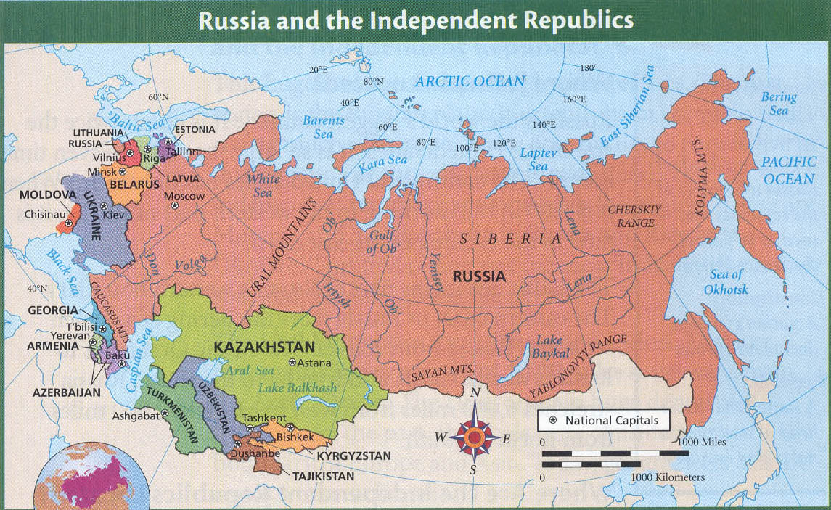

Slide 3
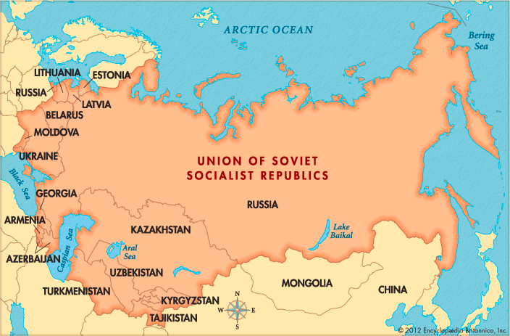

Slide 4
-The land area of Russia and the Republics covers three times the land area of the United States
-This area contains four regions:
-Northern European Plain
-West Siberian Plain
-Central Siberian Plateau
-Russian Far East

Slide 5
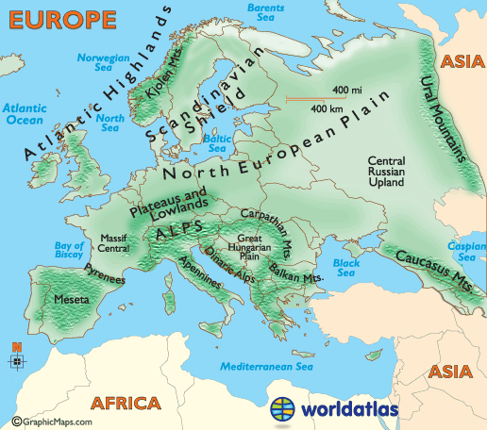
Northern European Plain

Slide 6
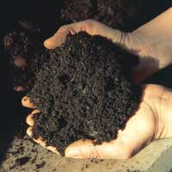
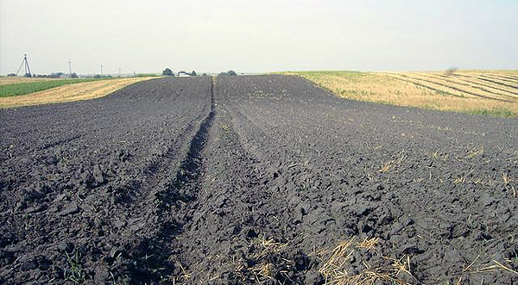
Northern European Plain
-Stretches from the Western border of Russia and the Republics to the Ural Mountains
-Contains chernozem, the world’s most fertile soil

Slide 7
Northern European Plain
-Nearly 75% of the 290 million people living in Russia and the Republics live in this region
-Three of the largest cities of Russia and the Republics are located in this region:
-Moscow
-St. Petersburg
-Kiev

Slide 8
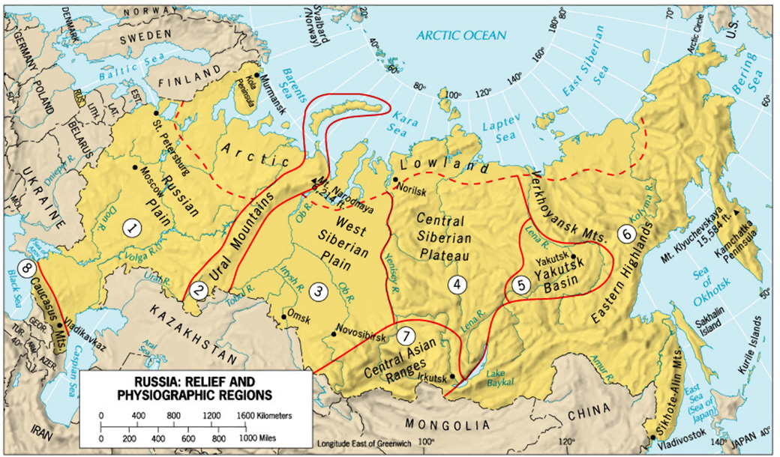
West Siberian Plain

Slide 9
West Siberian Plain
-Located between the Ural Mountains and Yenisey River
-Some consider the Ural Mountains to be the dividing line between Europe and Asia
-Others consider Europe and Asia to be a single continent called Eurasia

Slide 10
Central Siberian Plateau

Slide 11

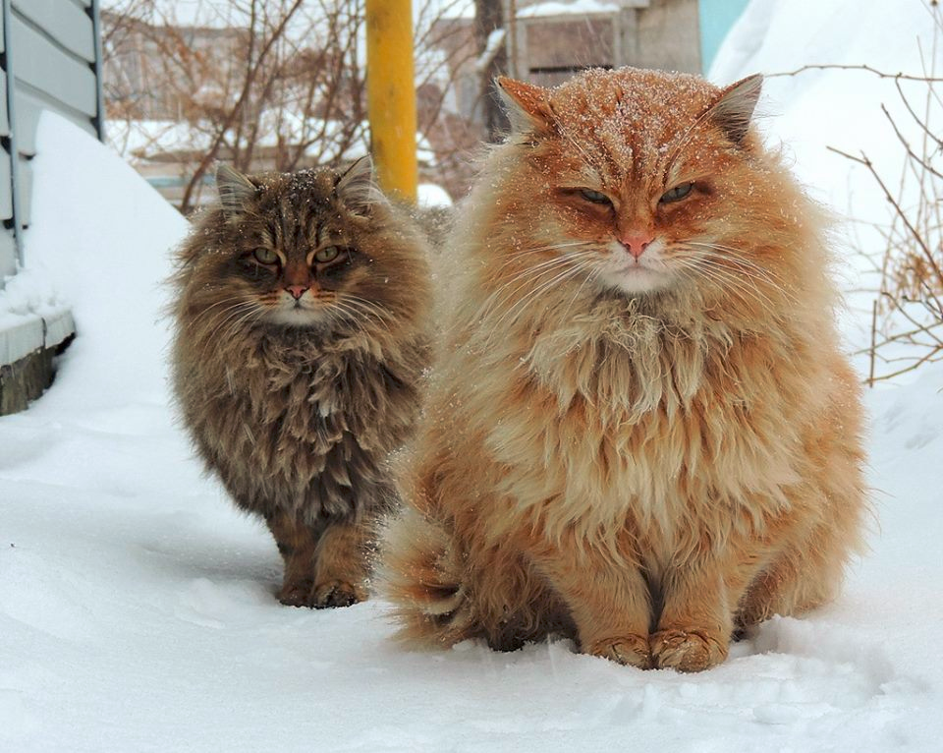
Central Siberian Plateau
-Located between the Yenisey River and Lena River
-Contains plateaus with average heights of 1,000 to 2,000 feet
Siberian cats!!!!!!!1!!

Slide 12
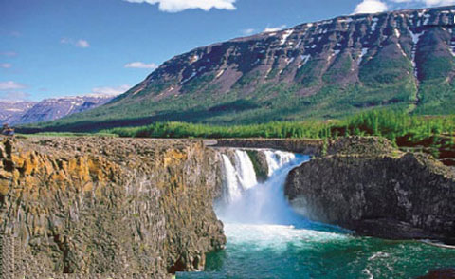
Central Siberian Plateau

Slide 13
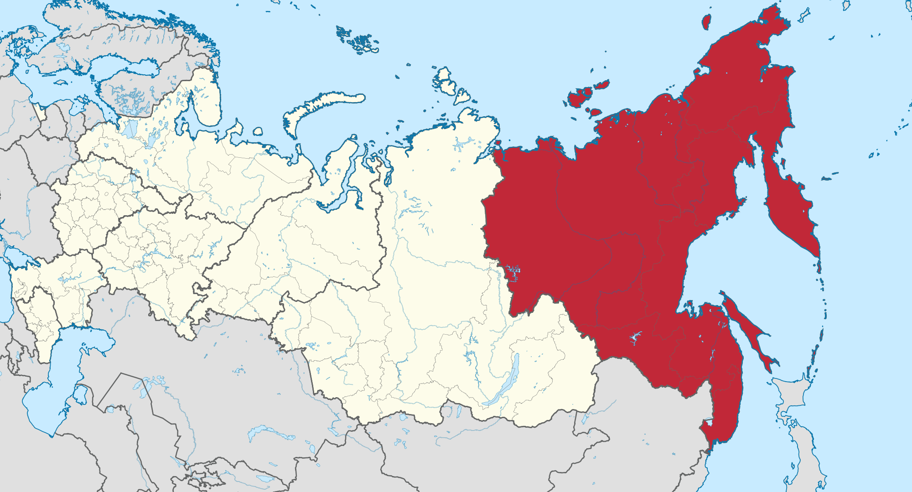
Russian Far East
-

Slide 14
Russian Far East
-Located east of the Lena River
-This region contains volcanoes, both active and inactive

Slide 15
Additional Regions
-Transcaucasia: a regions that consists of the countries of Armenia, Azerbaijan, and Georgia
-Central Asia: region that includes the countries of Kazakhstan, Kyrgyzstan, Tajikstan, Turkmenistan, and Uzbekistan

Slide 16
Lakes of Russia and the Republics
-Two of the largest lakes in the region are the Caspian Sea and the Aral Sea
-Both are actually saltwater lakes
-Since the 1960s, the Aral Sea has lost 80% of its water volume due to irrigation projects
-Lake Baikal in Russia is the deepest lake in the world
-Runs 400 miles north to south
-Holds 20% of the world’s fresh water

Slide 17
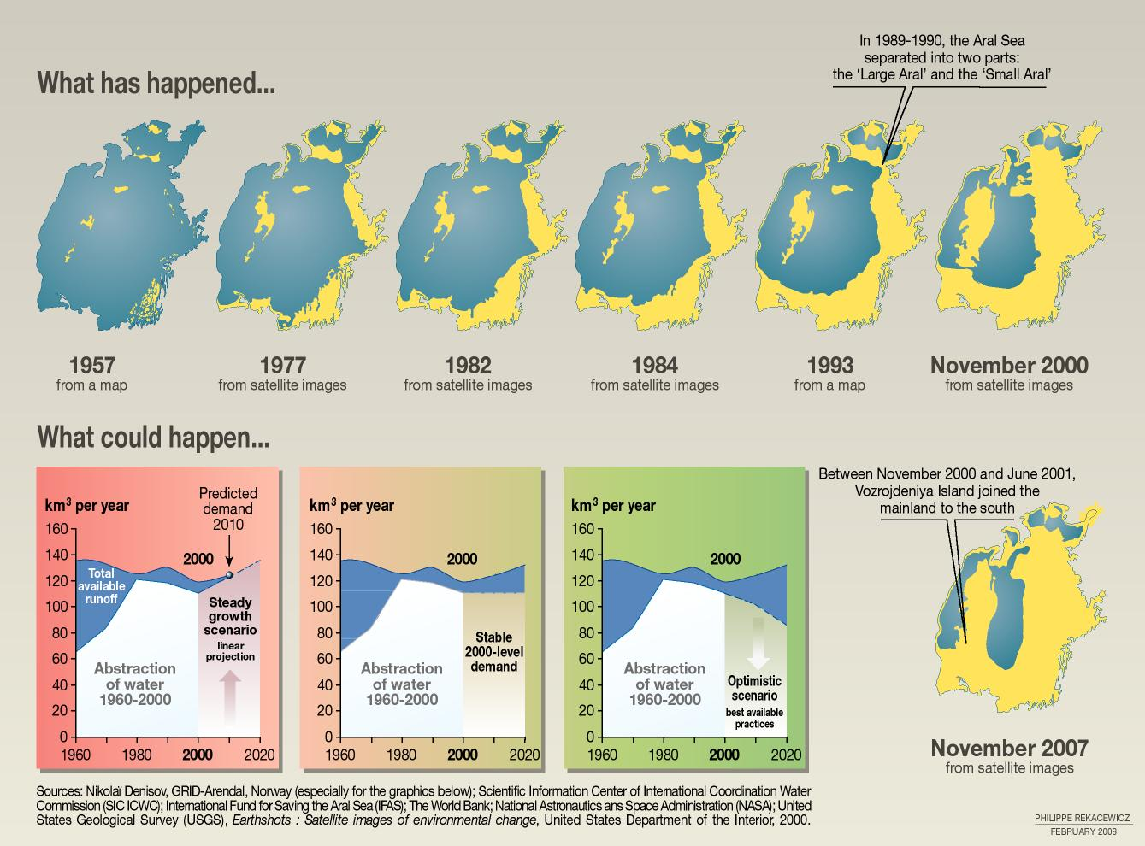

Slide 18
Natural Resources of Russia and the Republics
-This area contains reserves of coal and natural gas as well as deposits of iron ore
-Russia’s forests contain one-fifth of the world’s lumber
-Many resources are located in Siberia, an arctic/subarctic region of Russia
-Conditions in this region make it extremely difficult to extract resources

